Slide 1
Human-Robot Collaboration
Client: Dr. Michael Wollowski
Michael Crowell, Deven Dong, Walt Panfil, Adit Suvarna
October 24, 2018

Slide 2
Overarching Problem Statement
“Evaluate the feasibility of developing and evolving an understanding of shared context between a robot and a human collaborator using gesture and language.”
Integrate into UIMA pipeline
Implement feedback
Abstract understanding of environment
Implement gesture
Implement preprocessing

Slide 3
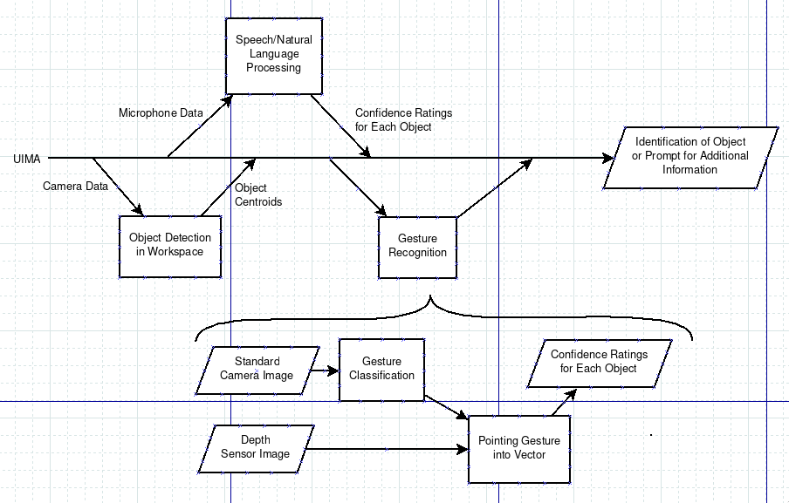
Architecture

Slide 4
Gesture Hypothesis and Relevant Requirements
“A vector serves as a sufficiently detailed abstraction of a pointing gesture. This abstraction determines to which object a pointing gesture is directed.”
The system shall respond to a pointing gesture from the user.
The system shall recognize blocks in the collaboration space.
The system shall locate blocks in the collaboration space.
The system shall inform the user of which block it has determined the user indicated.
The system shall provide feedback if it cannot distinguish between blocks.
Notes:
The major goal supported by these requirements is a prototype with an end-to-end pipeline
Even if that prototype is not full featured

Slide 5
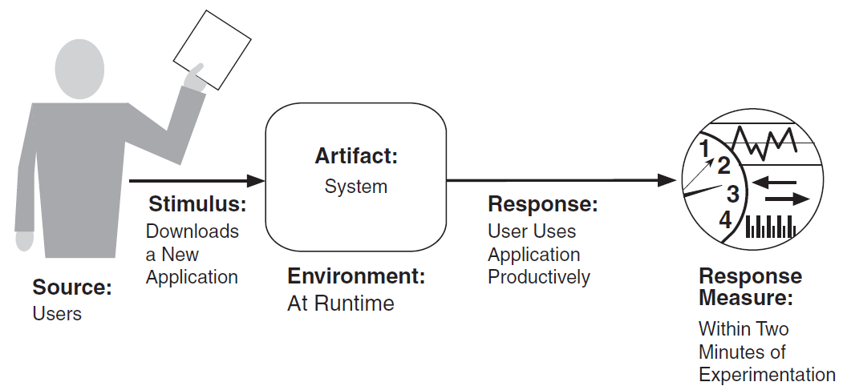
Scenario: Ambiguity and Resultant Feedback
System - Feedback
Cannot distinguish between several likely matches
System asks human collaborato for further clarification
System
Runtime
Within 10 seconds of collaborator instruction

Slide 6
Use Case: Collaborator Pointing
Alternate Flow:
System identifies several likely matching blocks (step 3).
System prompts user for additional information.
Return to step 1.
User responds that the selected block is not correct (step 5).
System records that processing was incorrect.
Return to step 1.
Post-Conditions:
System notifies user of the correct block OR
Returned to beginning of this use case.
Use Case: Pointing-Only Disambiguation
Description: User points to one of several blocks.
Actors: Human Collaborator
Pre-Conditions:
User is sitting in front of the system’s depth sensor. AND
The collaboration space is in view of the system’s camera.
Basic Flow:
User points towards a block.
System displays vector representing the pointing gesture.
System notifies user of the nearest block.
System prompts the user to determine if the selected block is the desired one.
User responds that the selected block is the desired one.
System records that processing was correct.

Slide 7
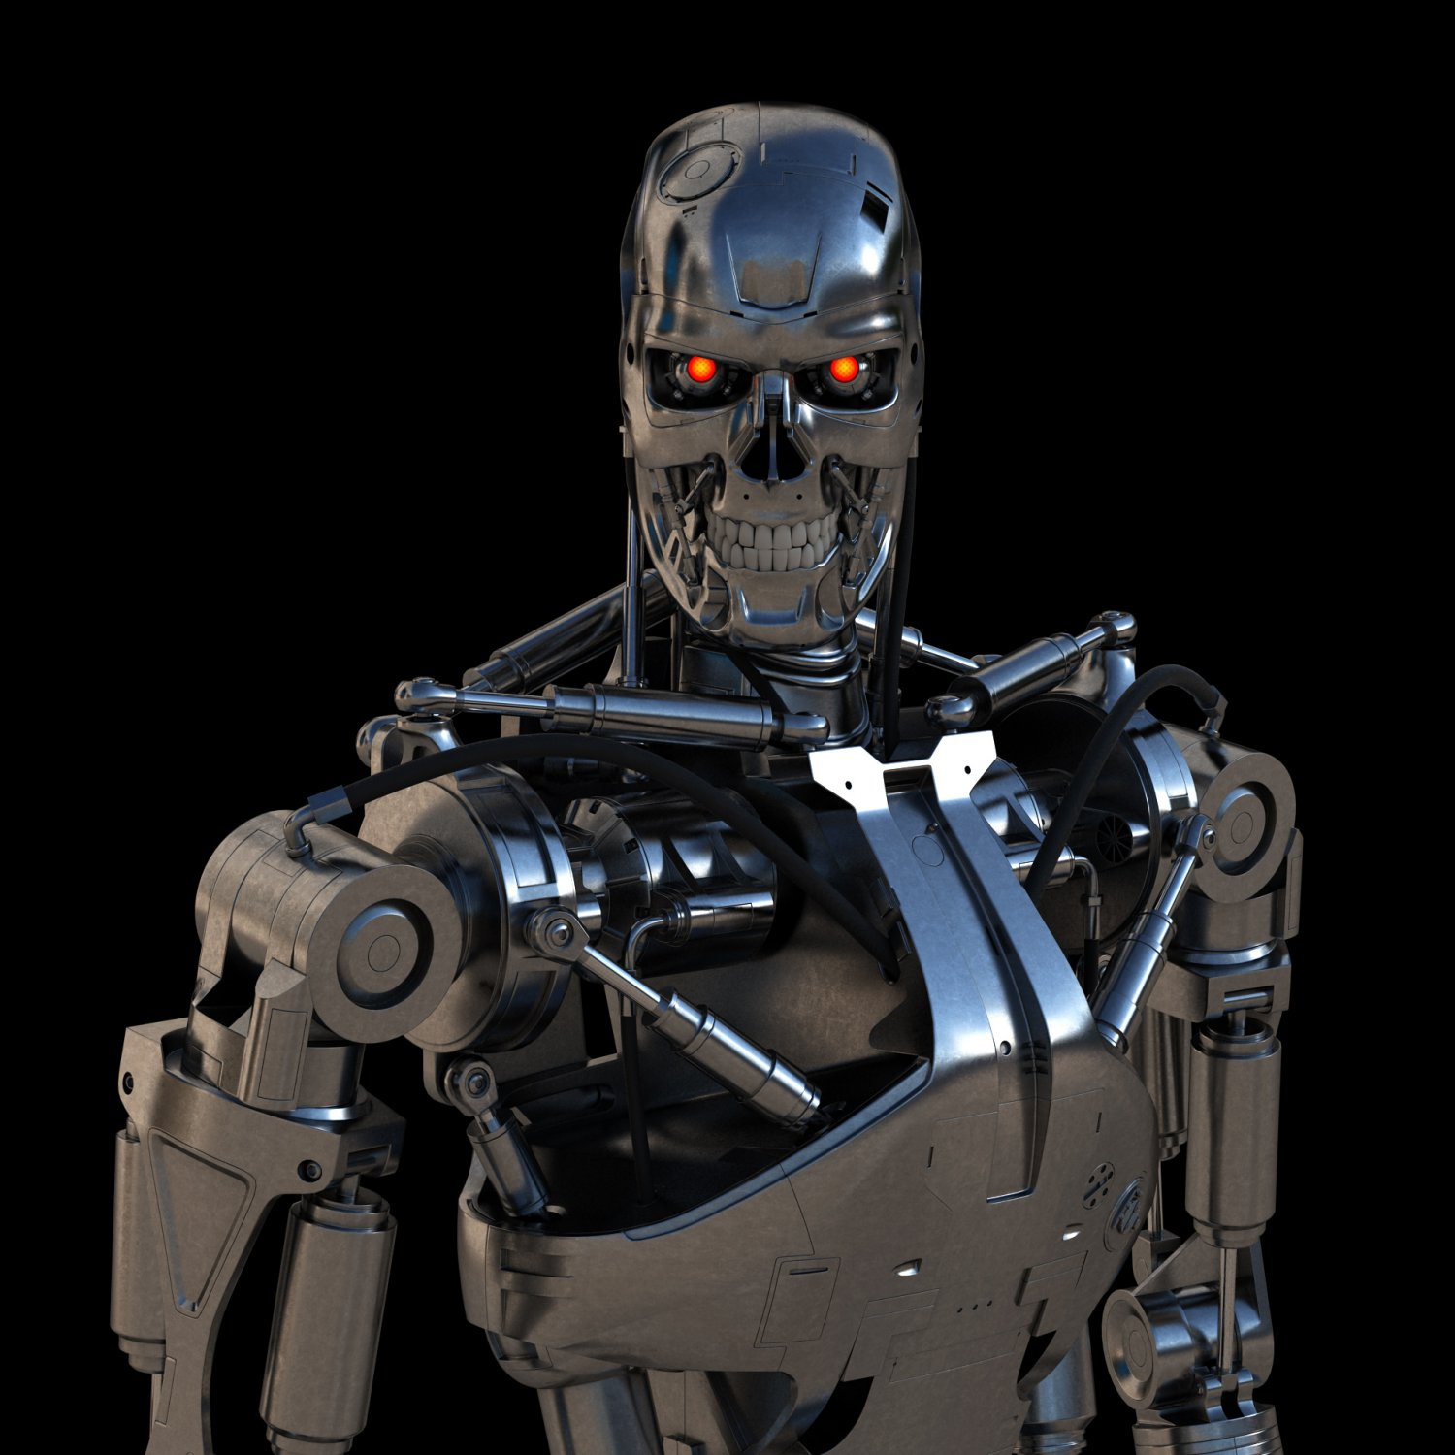
Questions?

